Slide 1
Off-Line Tuning
Start
On-Line Tuning
Start
Detection of disturbance
Detection of disturbance
Determining
Frequency
Amplitude
Bandwidth
Of disturbance
Halt/Pause the system
or
Deactivate the load
Start pre-defined routines
Activate the filtering
Calculate/Estimate/Predict
Electrical & Mechanical parameters
Calculate/Estimate/Predict
Electrical & Mechanical parameters
Set controller/driver
Update controller/driver
Reactivate the system
Trace next disturbance

Slide 2
Transmission
Load
PMSM Servo Motor
pulley-belt
lead-screw
rack-pinion
belt-wheel
conveyor
gear-wheel
direct drive
linear
rotational
contour
custom
motion
Coupler
Torsion
Flexion

Slide 3
Gear gap (backlash)
Tooth corrosion

Slide 4
Servo motor
Friction
Sliding
Sag

Slide 5
Servo Motor
Axis shift

Slide 6
Reference
Position
Speed
Torque
Current /Voltage
Real States
Real System
Driver+Servo+Load
+
Observed States
-
Model of Real System
K
Minimizing the error

Slide 7
Reference
Position
Speed
Torque
Current /Voltage
Real States
Real System
Driver+Servo+Load
+
Estimated States
-
Model of Real System
Estimator
Regression vector
Background data

Slide 8
Reference
Position
Speed
Torque
Current /Voltage
Real States
Real System
Driver+Servo+Load
+
Predicted States
-
Model of Real System
Predictor
Probabilities
Background data
Prediction
Update

Slide 9
Reference
Position
Speed
Torque
Current /Voltage
Reference Model
Driver+Servo+Load
+
error
-
Adjustable Model
Calculated
Parameters
Adaptive
mechanism

Slide 10

measured speed
Encoder
Transmission
+
Load
Servo Motor
Speed
Reference
-
Speed
Controller
Adaptive
Notch Filter
Torque
Controller
+
TF1
TF2
TFn
Disturbance
Detector
, BW, Q factor

Slide 11
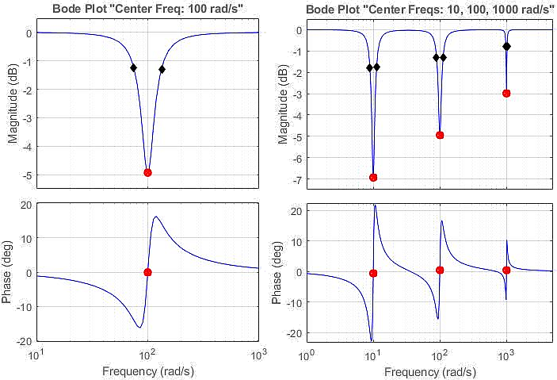
BW
Center Freq
Depth

Slide 12
TI TMS320F28335
32-bit MCU with 150 MIPS, FPU, 512 KB Flash, EMIF, 12b ADC
5kHz switching Freq SVPWM
Direct drive Adaptive PI controller + Estimator
(Online Parameter Estimation Technique for Adaptive Control Applications of Interior PM Synchronous Motor Drives)
NXP MPC8240 processor
64-bit floating-point, 250 MHz, 2 x 16KB cache, on-chip, 32 MB SDRAM, 8MB Flash, 16b ADC/DAC
10kHz Switching Freq
Belt drive two mass +Speed controller +Torque Control FOC (sampling 10kHz) + Pram identification
(Identification of Two-Mass Mechanical Systems Using Torque Excitation: Design and Experimental Evaluation)
(A friction model-based frequency response analysis for frictional servo systems) (friction response analysis FFT)
TMS320F28075
32-bit MCU with 120 MHz, FPU, TMU, 512 KB Flash, CLA, SDFM
10kHz SVPWM
Direct drive with torque sensor + Fuzzy network + Inertia identification
(Online Auto-Tuning Technique for IPMSM Servo Drive by Intelligent Identification of Moment of Inertia)

Slide 13
NXP MPC8240 processor
64-bit MCU with 250 MHz, FPU,
2 x 16KB cache, on-chip,
32 MB SDRAM, 8MB Flash,
16b ADC/DAC
(Identification of Two-Mass
Mechanical Systems Using Torque Excitation:
Design and Experimental Evaluation)
Process 1:
10kHz-SVPWM
Belt drive two mass
Speed controller
Torque Control FOC
Parameter identification
Process 2:
Nonlinear friction analysis
DFT
Linearization
(A friction model-based f
requency response analysis
for frictional servo systems)
(friction response analysis FFT)
XILINX Virtex-5 FPGA
64-bit MCU with 550 MHz, FIFO,
36-Kbit block RAM,
64-bit distributed RAM option,
(An FPGA-based parallel
architecture for
on-line parameter estimation
using the RLS identification
algorithm)
Process :
Position control (FOC)
RLS algorithm
Parameter identification
TI TMS320F28075
32-bit MCU with 120 MHz,
FPU, TMU, 512 KB Flash,
CLA, SDFM
Process:
10kHz-SVPWM
Direct drive
Fuzzy network
Inertia identification
(Online Auto-Tuning
Technique for IPMSM Servo Drive
by Intelligent Identification of
Moment of Inertia)
TI TMS320F28335
32-bit MCU with 150 MHz,
FPU, 512 KB Flash, EMIF,
12b ADC
Process:
5kHz-SVPWM
Direct drive
Adaptive PI controller
Estimator
(Online Parameter Estimation
Technique for Adaptive Control
Applications of Interior PM
Synchronous Motor Drives)
CPU clock
120MHz
150MHz
250MHz
340MHz

Slide 14
NXP MPC8240
64-bit MCU with 250 MHz
FPU, 2 x 16KB cache on-chip
32 MB SDRAM, 8MB Flash
Ex. Process 1:
10kHz-SVPWM
Belt drive two mass
Speed&Torque Control FOC
Parameter identification
Ex. Process 2:
Nonlinear friction analysis
DFT, Linearization
TI TMS320F28075
32-bit MCU, 120 MHz
FPU, TMU, 512 KB Flash
CLA, SDFM
Ex. Process:
10kHz-SVPWM
Direct drive
Fuzzy network
Inertia identification
TI TMS320F28335
32-bit MCU, 150 MHz
FPU, 512 KB Flash,
EMIF, 12b ADC
Ex. Process:
5kHz-SVPWM
Direct drive
Adaptive PI controller
Estimator
XILINX Virtex-5 FPGA
64-bit MCU with 550 MHz
FIFO, 36-Kbit block RAM
64-bit distributed RAM
Process :
Position control (FOC)
RLS algorithm - Online
Parameter identification
120MHz
150MHz
250MHz
340MHz
CPU
clock

Slide 15
d-axis
d-axis
q-axis
q-axis
PM
g
g
h
SPMSM
h
IPMSM

Slide 16






Load
Servo

Slide 17




-
+
-
+
-
+

Slide 18





Adjustable
Model
Position
Controller
Analyzer
Freq. Domain
Time Domain
Adaptive
Numerical
Observer
Estimator
Predictor
AI Based
Filtering
Speed
Controller
+
+
error
or
data
+
+
-
-
-
Torque
Controller
-
Current
Voltage
Controller
Driver
PMSM
Disturbance
Load

Slide 19
feedback
Servo
Drive Train
Ref
Controller
Driver
option 3
Disturbance
Filter
FFT
+
DSP
option 2
Notch
Bi-quad
LPF,BPF,HPF
Disturbance
detection
characterization
option 1

